Slide 1
COPADS
#12 – Parallel Computing
IFEOLUWATAYO IGE

Slide 2
Outline
Flynn’s Taxonomy
Parallel Computing Hardware
Parallel Computing Software
Performance Metrics For Parallel Systems
Scalability in Parallel Computing

Slide 3
BACKGROUND
To build a house; if it takes one person ten months to build one house;
it will take ten people one month to build one house.
it will take 100 people one-tenth of a month to build one house. REALLY?
DO YOU THINK BOTH POINTS ARE ACHIEVABLE?
When 100 people are running about, they will get in each others’ way; fight over limited resources like bricks
When there are more workers, you will need more managers — not building themselves but making sure workers are doing the right things.
From the above example, we can see that simply adding more people won’t necessarily get it done faster
Sometimes adding more people will make it go slower as they get in each other’s way

Slide 4
Another Way?
To build a house; if it takes one person ten months to build one house;
it will take ten people ten months to build ten houses.
it will take one person 100 months to build ten houses.
it will take ten people 100 months to build 100 houses.
All the above looks achievable,
By simplifying adding more people we can build more houses simultaneously
But in reality, we may not get a perfect speedup like this, due to resource contention issues, but we can get pretty close.

Slide 5
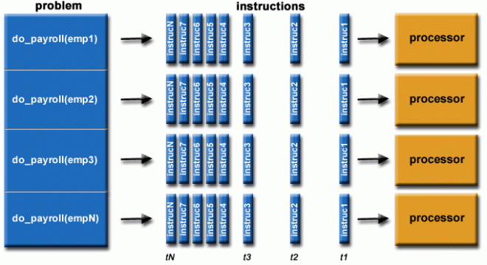
Parallel Computing
Parallel computing is the simultaneous use of multiple computing resources to solve a problem:
A problem is broken into discrete parts that can be solved concurrently
Each part is further broken down into a series of instructions
Instructions from each part execute simultaneously on different processors
The compute resources could be:
A single computer with multiple processors/cores
An arbitrary number of such computers connected by a network
Parallel Computing:
saves time while solving large problems that are impossible to solve on a single computer
Provides concurrency
Examples: Super Computers
November 2023 | TOP500

Slide 6


Parallel Computing
Distributed computing - spreading a computation across different network nodes.
Parallel computing -- allowing multiple parts of a computation to happen at the same time
Distributed Computing

Slide 7
Flynn’s Taxonomy for Parallel Computer Architectures
This is a taxonomy (developed in 1966) that classifies parallel computer architectures along the two independent dimensions of Instruction Stream and Data Stream. Each of these dimensions can have only one of the two possible states: Single or Multiple.

Slide 8
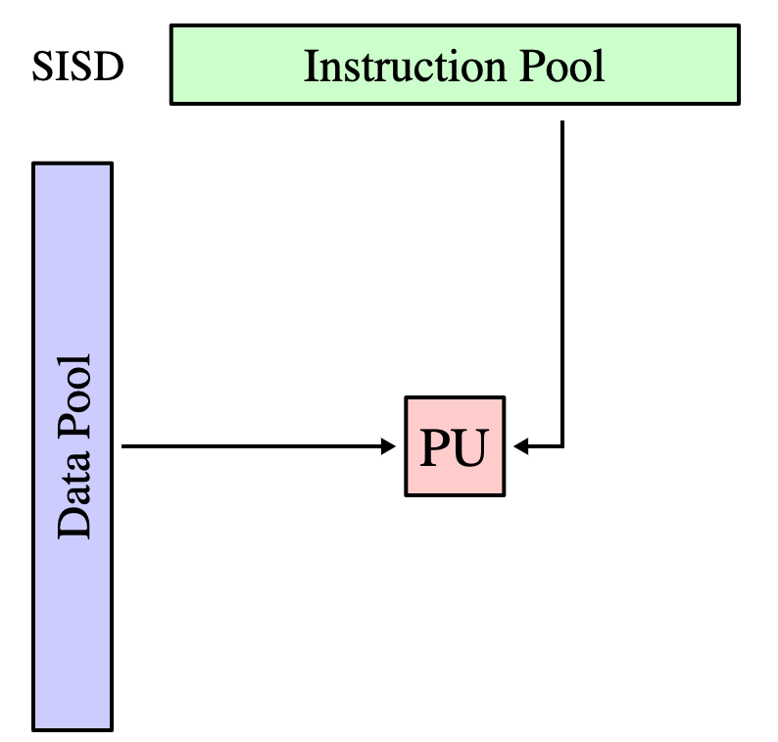
Single Instruction/Single Data Stream (SISD)
A serial (non-parallel) computer
Single Instruction: Only one instruction stream is being acted on by the CPU during any one clock cycle
Single Data: Only one data stream is being used as input during any one clock cycle
Deterministic execution
This is the oldest type of computer
Examples: older generation mainframes,
minicomputers, and single
processor/core PCs.

Slide 9
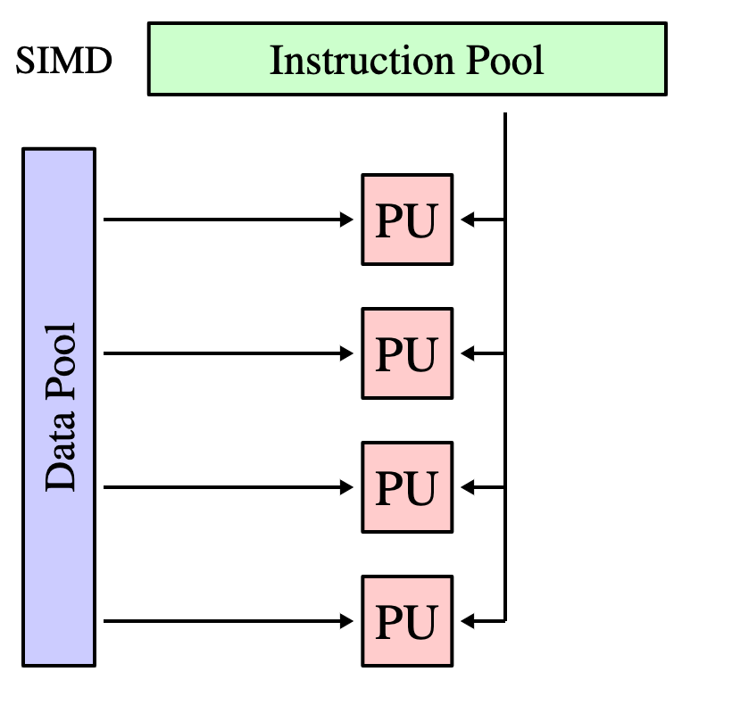
Single Instruction/Multiple Data Streams (SIMD)
A type of parallel computer
Single Instruction: All processing units execute the same instruction at any given clock cycle
Multiple Data: Each processing unit can operate on a different data element
Best suited for specialized problems characterized by a high degree of regularity (graphics/image processing) such as adjusting the contrast in a digital image.

Slide 10
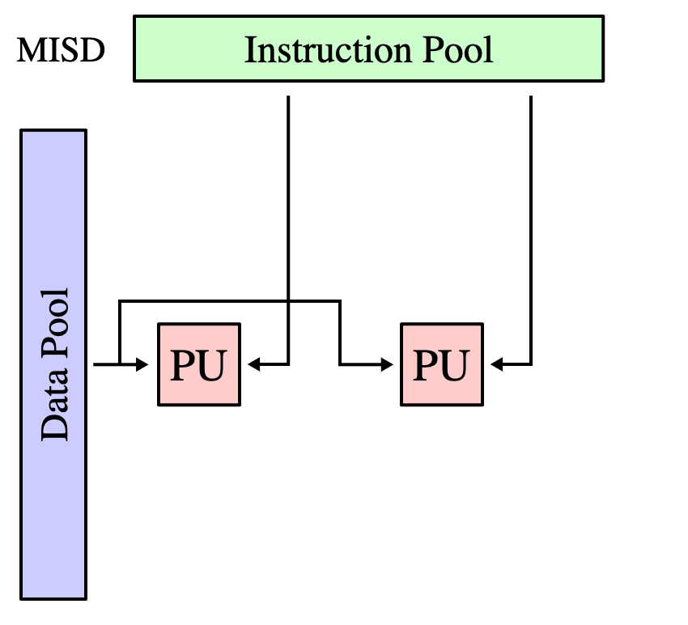
Multiple Instruction/Single Data Streams (MISD)
A type of parallel computer
Multiple Instruction
Single data stream is fed into multiple processing units.
This is an uncommon architecture. Its possible uses could be implementing multiple cryptography algorithms while attempting to crack a single coded message

Slide 11
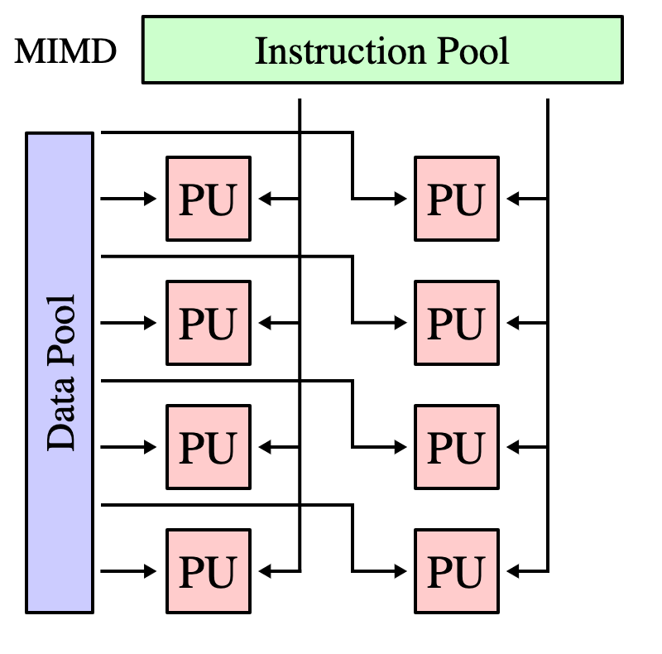
Multiple Instruction/Multiple Data Stream (MIMD)
Multiple Instruction: Every processor may be executing a different instruction stream
Multiple Data: Every processor may be working with a different data stream
Execution can be synchronous or asynchronous.
It is currently the most common type of parallel computer - most modern supercomputers fall into this category.
Examples: most current supercomputers, networked parallel computer clusters and "grids", multi-core PCs

Slide 12
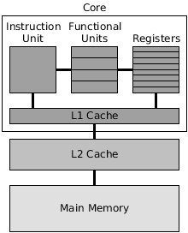
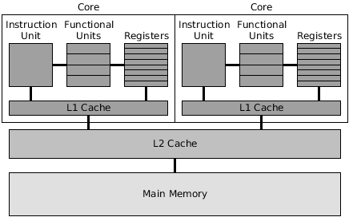
1. Single Core 2. Multi Core
Parallel Computing Hardware

Slide 13
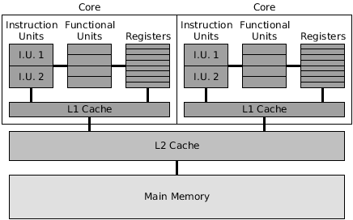
3. Multicore Hyper-threading
Introduced by Intel
More than one thread can run on each core
One physical core now works like two “logical cores” that can handle different software threads.
Two logical cores can work through tasks more efficiently than a traditional single-threaded core

Slide 14
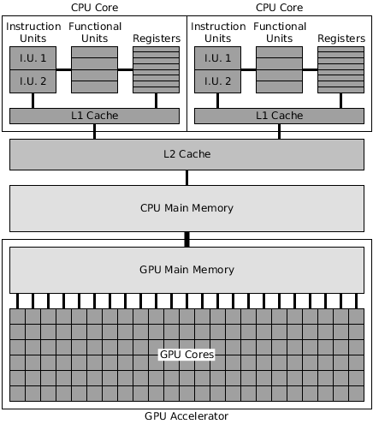
4. GPU Accelerated
Developed by NVIDIA
Their processors are designed to work with a small series of instructions across a potentially vast amount of data.
Used to facilitate processing-intensive operations such as 3D graphics rendering, deep learning, analytics, medical imaging, simulations, etc.
More computing power for performing the same operation on multiple data elements simultaneously.

Slide 15
5. Parallel Clusters
What are clusters?
Nodes in a cluster are usually connected through high-speed local area networks. Similar tasks are assigned to each node. Each node runs its instance of an operating system.
Why use clusters?
To overcome low resource problems and poor performance due to large tasks running simultaneously on a single node
To solve problems requiring more cores than can fit in one node
To solve problems requiring more GPUs than can fit in one node
To solve problems requiring more main memory than can fit in one node
To solve problems requiring more disk storage than can fit in one node
Example: Server Clusters..,

Slide 16
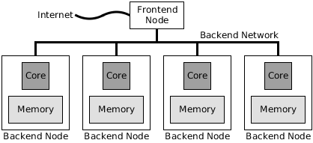
5a. Single Core Node parallel Clusters (Now outdated)

Slide 17
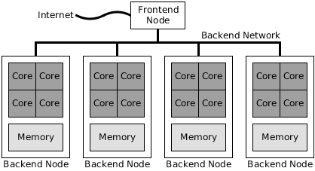
5b.Multicore Node Parallel Clusters

Slide 18
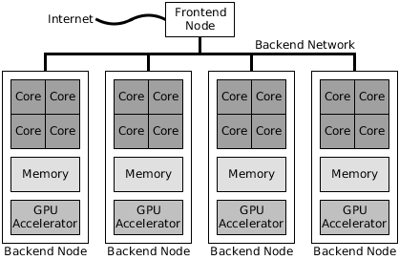
5c.GPU Accelerated Cluster

Slide 19
Parallel Computing Software
Multicore parallel programs
Multicore-cluster (hybrid) programs
GPU-accelerated parallel programs

Slide 20
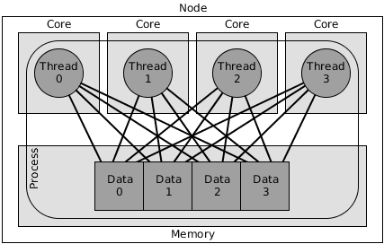
Multicore Parallel Programs
One Process
Multiple Threads (one per core)
Mode of communication: Shared memory
Multicore Libraries:
OpenMP
PJ2: Java
C# Parallel

Slide 21
Cluster Parallel Programs
Multiple Processes, one per core
One or more threads per Process
No Thread synchronization issues
No Shared Data
Mode of communication: Message Passing
Cluster Libraries:
Message Passing Interface Library (MPI)
CORBA (Common Object Request Broker Architecture)

Slide 22
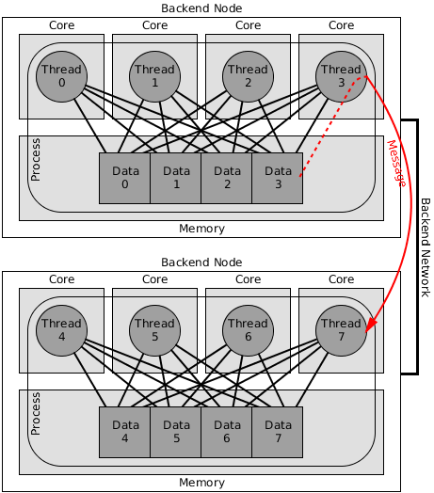
Multicore Clustered Parallel Programs
One process per node
Multiple Threads per process, one thread per core
Shared memory, parallel programming within a node
Message passing between nodes

Slide 23
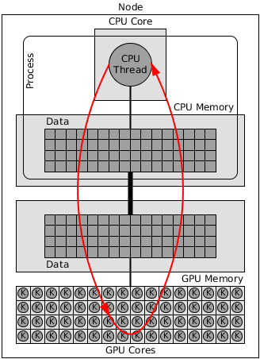
GPU Accelerated Parallel Programming
CPU sets up input data in CPU memory
CPU copies input data from CPU memory to GPU memory
GPU executes a computational kernel
GPU runs a large number of threads
Each thread takes input data from GPU memory, computes results, stores results back in GPU memory
CPU copies output data from GPU memory to CPU memory
CPU reports results
GPU Libraries:
NVIDIA Corporation's Compute Unified Device Architecture (CUDA)—vendor-specific.
Khronos Group’s OpenCL (Open Computing Language)—vendor-independent

Slide 24
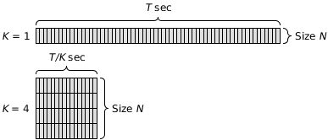
PERFORMANCE METRICS FOR PARALLEL SYSTEMS
PROBLEM STATEMENT
There is a fixed problem size, but the number of processors increases (k)
Best Solution you can think of:
Solve the same problem size (amount of computation) on K times as many processors
It should ideally reduce the running time by a factor of K
WILL THIS WORK FOR ALL SCRIPTS/CODE?

Slide 25
1. Execution Time for Parallelization
There are three components to the execution time that a parallel algorithm would require if it were implemented:
The part of the computation that must be performed sequentially, called the inherently sequential part of the computation,
The part of the computation that can be performed in parallel, called the parallelizable part of the computation,
The overhead that the parallel algorithm has, but which the sequential algorithm does not, which includes:
communication overhead between cores
computations that are performed redundantly
the overhead of creating multiple processes.

Slide 26
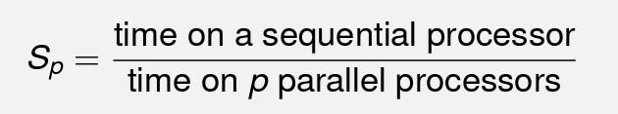
2. Speedup
Having p processors won’t necessarily make our program run p times as fast
The speedup using p processors is
Ideally, we’d like S_{p} = p, but this never happens
Sp could be smaller than p:
there is communication overheads between processors. This might be fairly small for shared memory, or large for distributed memory, but it is present
Time spent communicating is time not spent computing

Slide 27
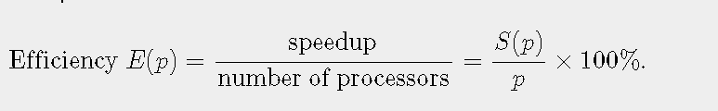
3. Efficiency
Efficiency is speedup per processor:
Usually 0 ≤ Ep ≤ 1, and is often written as a percentage
Ep =0.5 (50%) means we are using only half of the processors’ capabilities on your computation; half is lost in overheads or idling while waiting for something
Ep =1(100%) means we are using all the processors all the time on our computation
Ep >1indicate super linear speedup: we are using more than 100% of the processors which is rare!
When Ep <1, this indicates that somewhere at some point, a processor is not working on the computation. Perhaps it is just lying idle waiting
Efficiency is useful when we need to gauge the cost of a parallel system: the higher the efficiency the better the utilization of the processors.

Slide 28
Scalability in Parallel Computing

Slide 29

Amdahl’s law
In 1967, Amdahl pointed out that for a fixed-size problem, you may decide to increase the number of processors to increase the speedup, but the speedup is limited by the fraction of the sequential part of the code (which is fixed) that is not amenable to parallelization
He also stated that the upper limit of speedup is determined by the sequential fraction of the code. This is called strong scaling.
Amdahl’ s law states: Let f be the fraction of operations in a computation that must be performed sequentially, where 0 ≤ f ≤ 1. The maximum speedup ψ achievable by a parallel computer with p processors for this computation is
Upper limit of speedup = 1/f
where f is the proportion of execution time spent on the sequential part.
(1-f) is the proportion of execution time spent on the part that can be parallelized

Slide 30
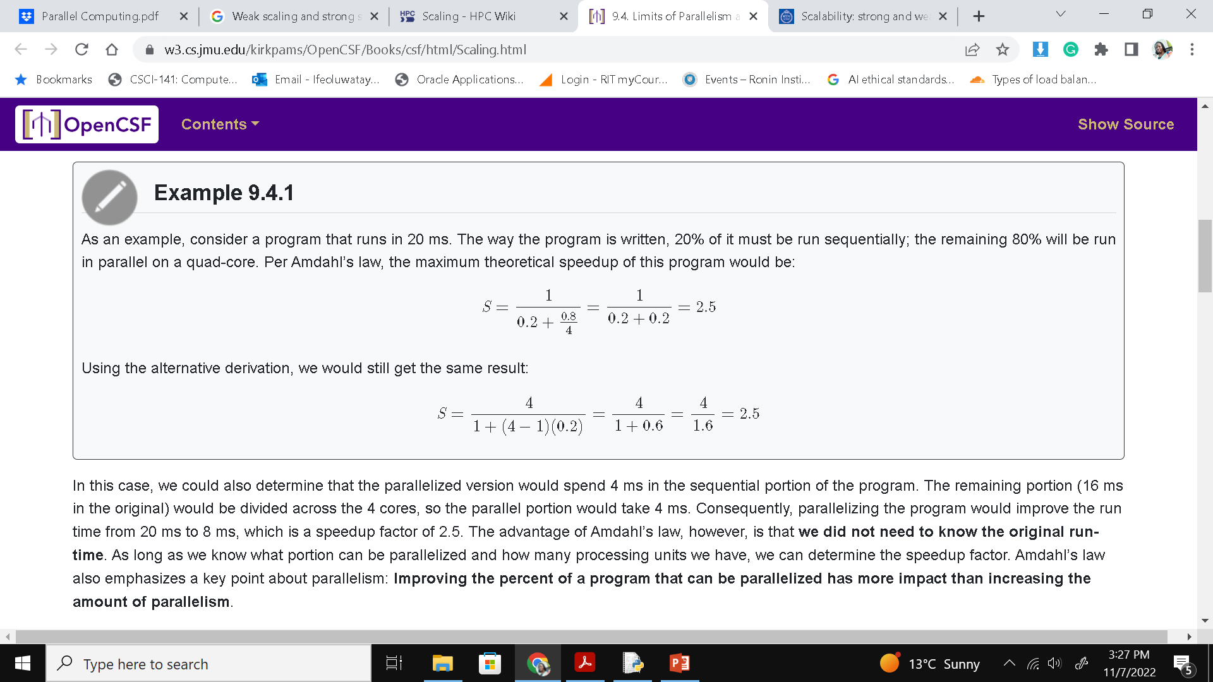
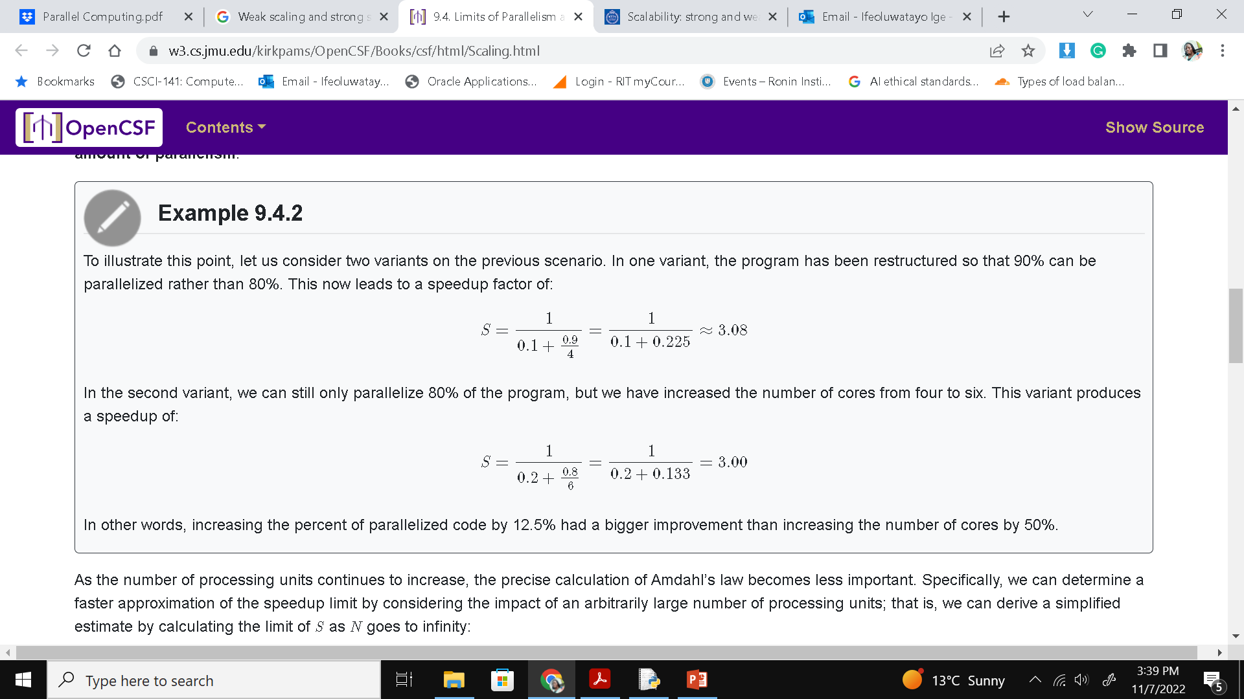
Amdahl’s law also emphasizes that improving the percentage of a program that can be parallelized has more impact than increasing the amount of parallelism (cores).

Slide 31
Consider a program that takes 20 hours to run using a single processor core. Suppose a particular part of the program, which takes one hour to execute, cannot be parallelized
If the code that takes up the remaining 19 hours of execution time can be parallelized, then regardless of how many processors are devoted to a parallelized execution of this program, the minimum execution time cannot be less than that critical one hour.
Parallel computing with many processors is only useful for highly parallelized programs.

Slide 32
Gustafson’s law
Gustafson in 1988 argued that people do not take a fixed-size problem and run it on varying numbers of processors to decrease running time, except when doing academic research ☺.
Instead, he noted, “When given a more powerful processor, the problem generally expands to make use of the increased facilities”.
In other words, when the number of processors increases, people use the larger number of processors to solve a larger problem in the same amount of time.
Gustafson’s law states “Given a parallel program solving a problem of size n in a given amount of time using p processors,
let s denote the fraction of the program's total execution time spent executing inherently sequential code. The scaled speedup achievable by this program, as a function of the number of processors p, is
Scaled Speedup S_{s}(p) = p+(1−p)s
Notes:
Notes taken from Prof. Stewart Weiss @chrome-extension://efaidnbmnnnibpcajpcglclefindmkaj/https://www.cs.hunter.cuny.edu/~sweiss/course_materials/csci493.65/lecture_notes_2014/chapter07.pdf

Slide 33
With Gustafson’s law the scaled speedup increases linearly with respect to the number of processors and there is no upper limit for the scaled speedup.
This is called weak scaling, where the scaled speedup is calculated based on the amount of work done for a scaled problem size (in contrast to Amdahl’s law which focuses on fixed problem size)
Example:
Suppose benchmarking reveals that 5% of a program running on a 64-processor machine is non-parallelizable. Compute the scaled speedup.
p=64, s=0.05
S_{s}(p)= 64+(1−64)0.05
= 64−3.15 = 60.85.

